Slide 1
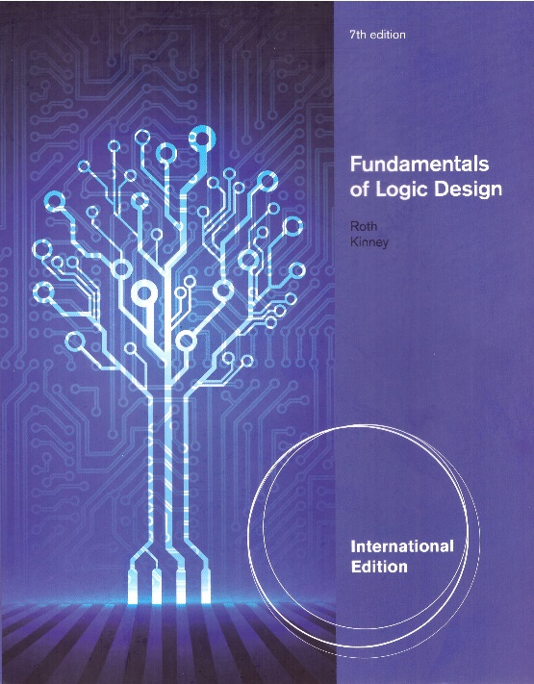
Unit 11
LATCHES AND FLIP-FLOPS
This chapter in the book includes:
Objectives
Study Guide
11.1 Introduction
11.2 Set-Reset Latch
11.3 Gated D Latch
11.4 Edge-Triggered D Flip-Flop
11.5 S-R Flip-Flop
11.6 J-K Flip-Flop
11.7 T Flip-Flop
11.8 Flip-Flop with Additional Inputs
11.9 Summary
Problems

Slide 2
Objectives
Explain in words the operation of S-R and gated D latches
2. Explain in words the operation of D, D-CE, S-R, J-K and
T flip-flops
3. Make a table and derive the characteristic (next-state) equation
for such latches and flip-flops. State any necessary restrictions on
the input signals
4. Draw a timing diagram relating the input and output of such latches
flip-flops
5. Show how latches and flip-flops can be constructed using gates.
Analyze the operation of a flip-flop that is constructed of gates and
latches

Slide 3
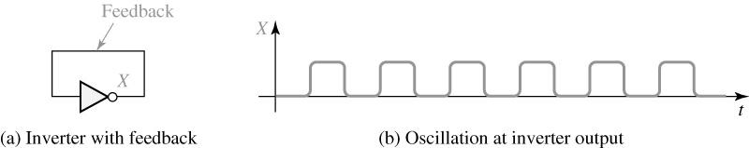
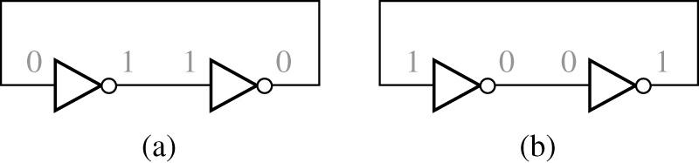
11.1 Introduction
To construct a switching circuit having a memory,
we must introduce a feedback to the circuit
Fig 11-1
➔ Unstable state
Fig 11-2
➔ Stable state

Slide 4
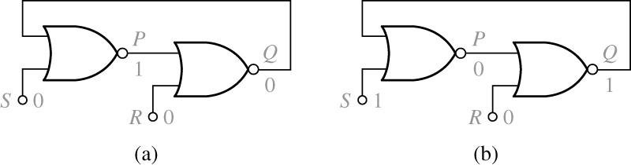
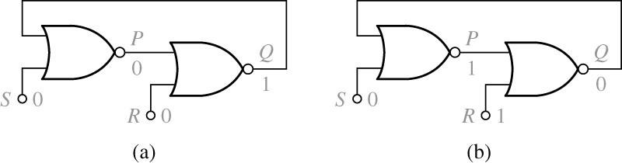
11.2 Set-Reset Latch
Fig 11-3
S=R=0 (Q=0) → S=1, R=0
Fig 11-4
S=R=0 (Q=1)→ S=0, R=1

Slide 5
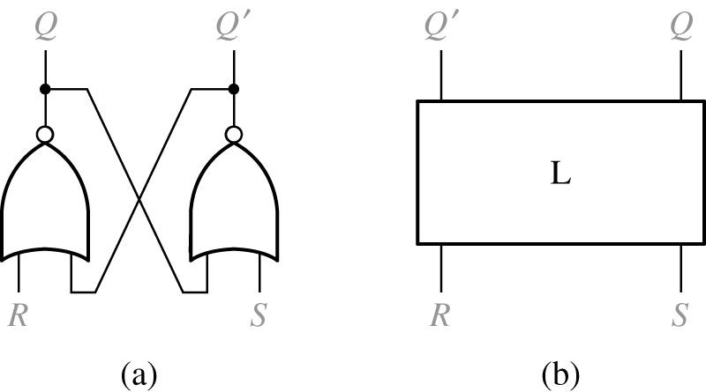
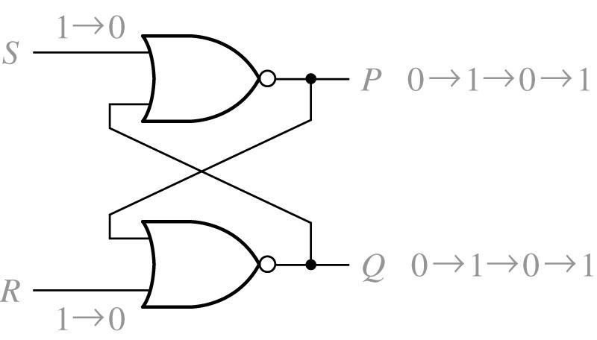
11.2 Set-Reset Latch
Fig 11-5 S-R Latch (cross-coupled structure)
Fig 11-6 Improper S-R Latch Operation (S=R=1; prohibited)

Slide 6
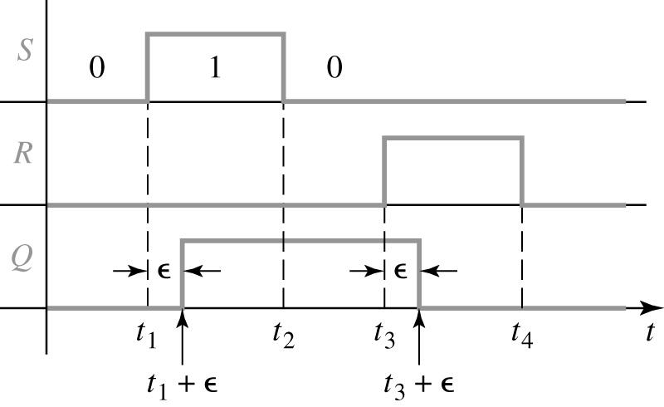
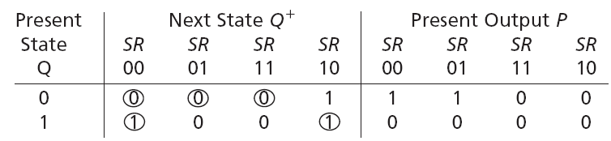
11.2 Set-Reset Latch
Fig 11-7 Timing Diagram for S-R Latch
Table 11-1 S-R Latch Operation
stable

Slide 7
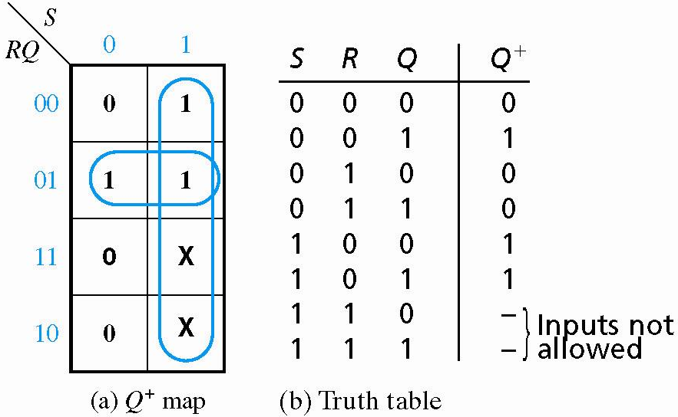
11.2 Set-Reset Latch
Fig 11-8 Derivation of Q⁺ for an S-R Latch
No Change
R=1 Reset
S=1 Set

Slide 8
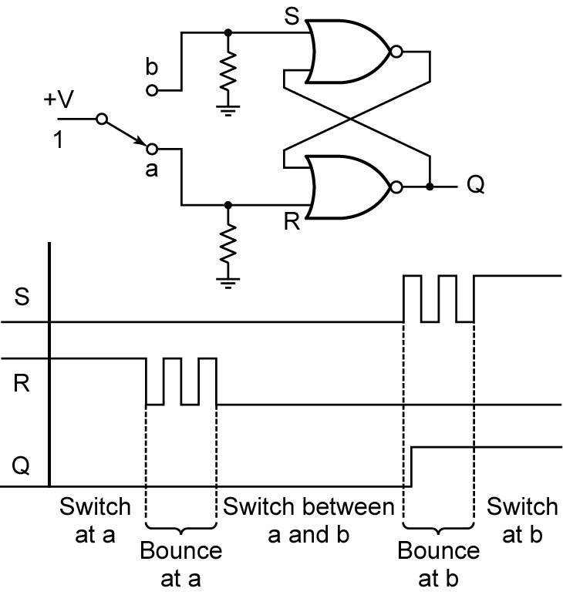
11.2 Set-Reset Latch
Fig 11-9 Switch Debouncing with an S-R Latch

Slide 9
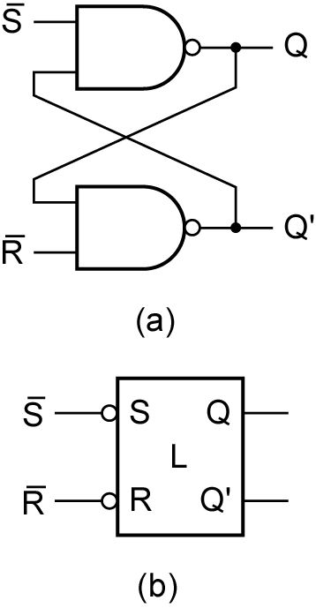
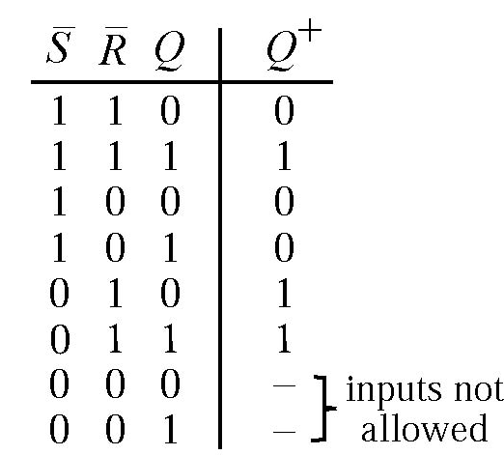
11.2 Set-Reset Latch
Fig 11-10. - Latch

Slide 10
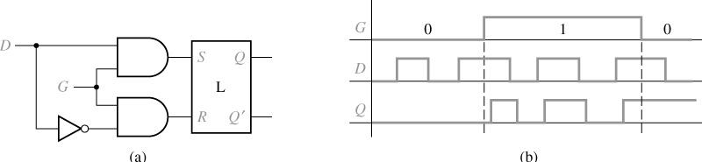
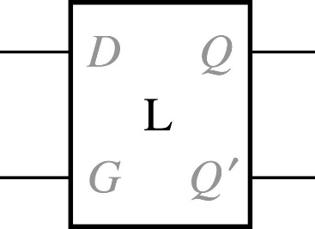
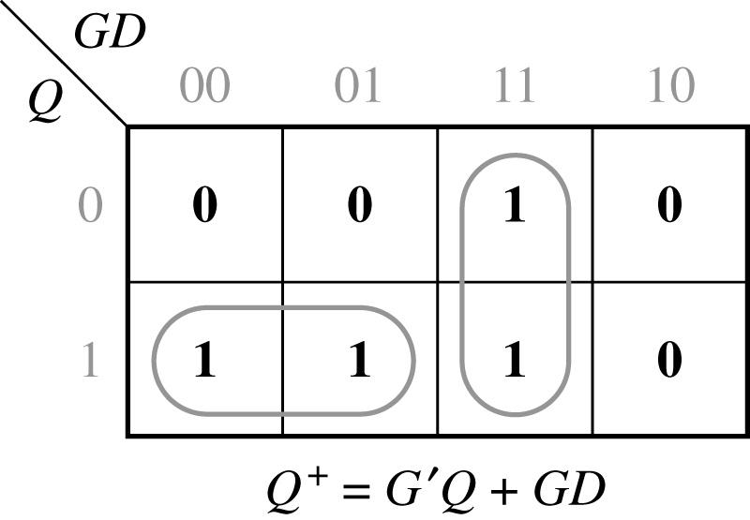
11.3 Gated D Latch
Figure 11-11 Gated D Latch
Figure 11-12 Symbol and Truth Table for Gated Latch
0 0 0 0 0 1 0 1 0 0 1 1 1 0 0 1 0 1 1 1 0 1 1 1 | 0 1 0 1 0 0 1 1

Slide 11
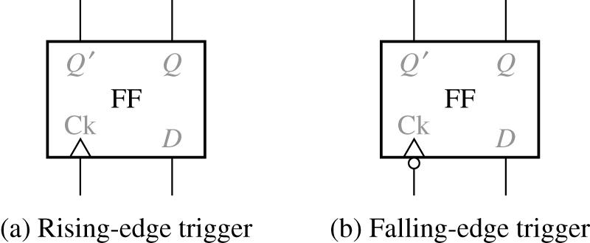
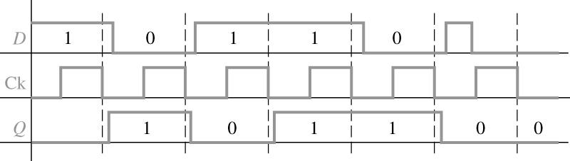
11.4 Edge-Triggered D Flip-Flop
Figure 11-13 D Flip-Flops
0 0
0 1
1 0
1 1
0
0
1
1
Truth table
Figure 11-14 Timing for D Flip-Flop (Falling-Edge Trigger)

Slide 12
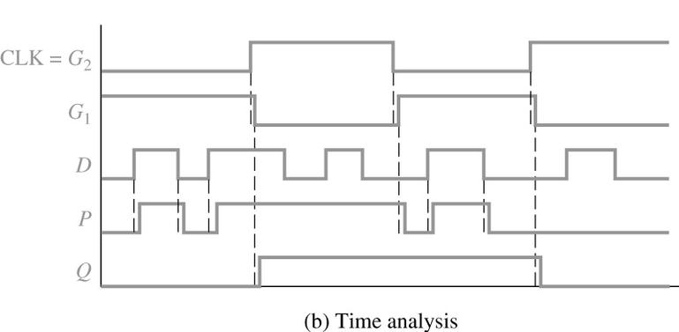
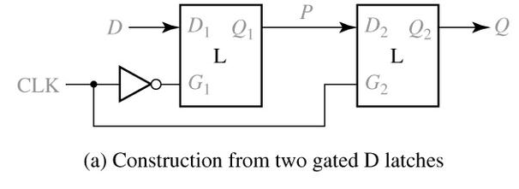
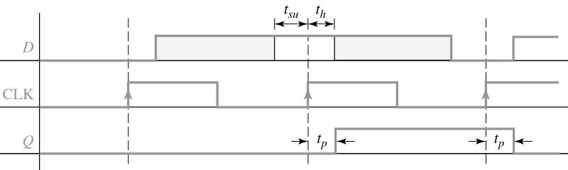
11.4 Edge-Triggered D Flip-Flop
Figure 11-15 D Flip-Flop (Rising-Edge Trigger)
Figure 11-16 Setup and Hold Times for an Edge-Triggered D Flip-Flop

Slide 13
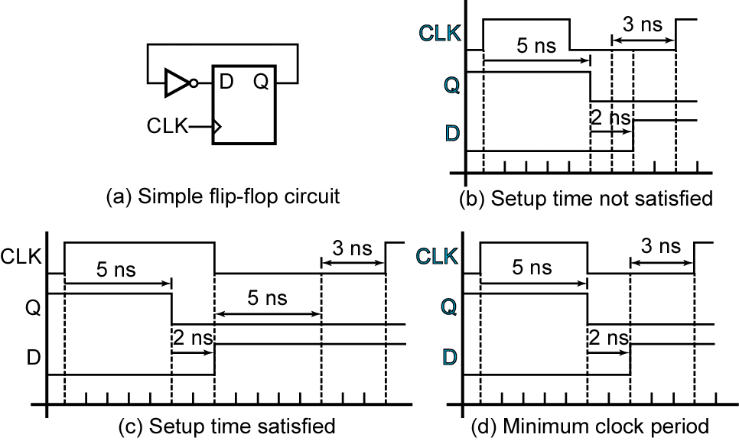
11.4 Edge-Triggered D Flip-Flop
Figure 11-17 Determination of Minimum Clock Period
t_{pd} = 2 ns
t_{pd} = 5 ns
t_{su} = 3 ns

Slide 14
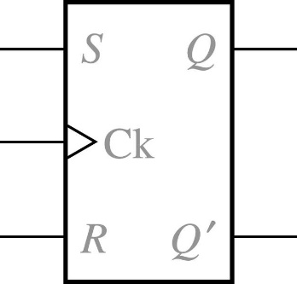
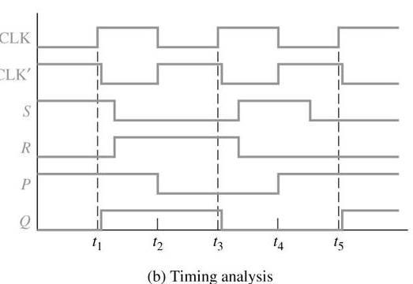
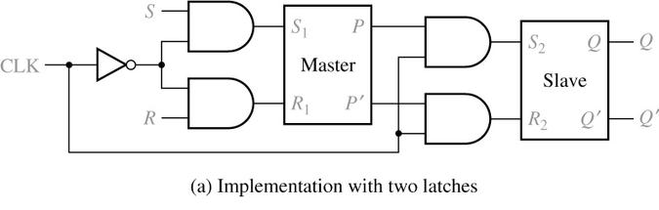
11.5 S-R Flip-Flop
Figure 11-18 S-R Flip-Flop
Operation summary :
S=R=0
No state change
S=1, R=0
Set Q to 1 (after active Ck edge)
S=0, R=1
Reset Q to 0 (after active Ck edge)
S=R=1
Not allowed
Figure 11-19 S-R Flip-Flop Implementation and Timing

Slide 15
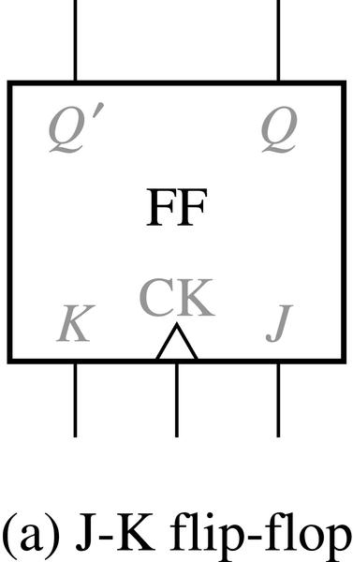
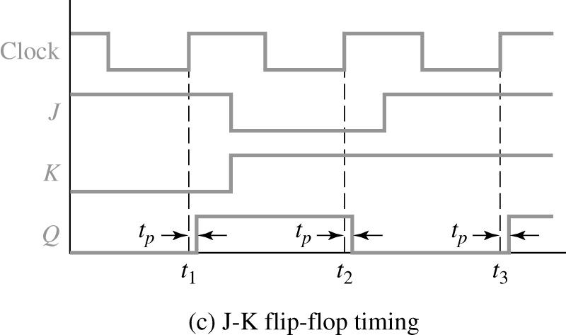
11.6 J-K Flip-Flop
Figure 11-20 J-K Flip-Flop (Q Changes on the Rising Edge)
0 0 0 0 0 1 0 1 0 0 1 1 1 0 0 1 0 1 1 1 0 1 1 1 | 0 1 0 0 1 1 1 0
J=K=0, No Change
K=1 Kill, Reset
J=1 Jump, Set
J=K=1, Toggle
Truth table and characteristic equation

Slide 16
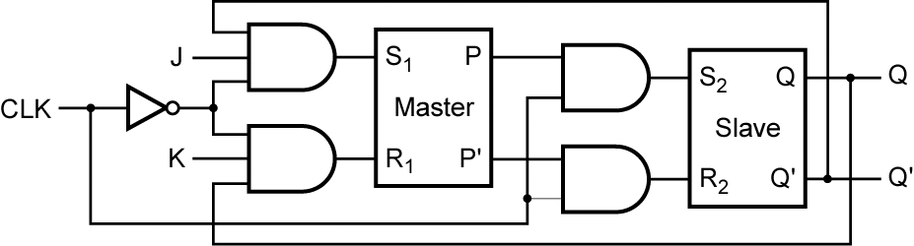
11.6 J-K Flip-Flop
Figure 11-21 Master-Slave J-K Flip-Flop (Q Changes on Rising Edge)
With J = K = 1, a cross-coupled connection between inputs and outputs
-> Toggle operation

Slide 17
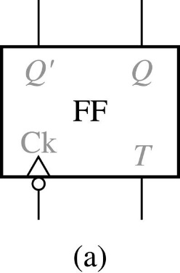
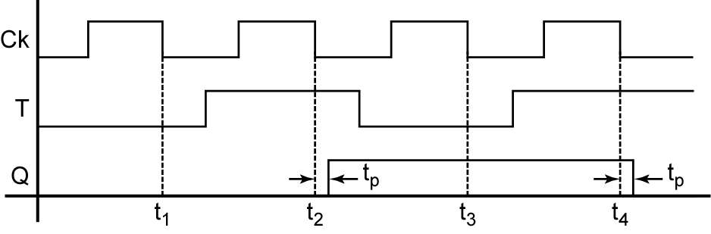
11.7 T Flip-Flop
Figure 11-22 T Flip-Flop
0 0 0 1 1 0 1 1 | 0 1 1 0
T=0, No Change
T=1, Toggle
Figure 11-23 Timing Diagram for T Flip-Flop (Falling-Edge Trigger)

Slide 18
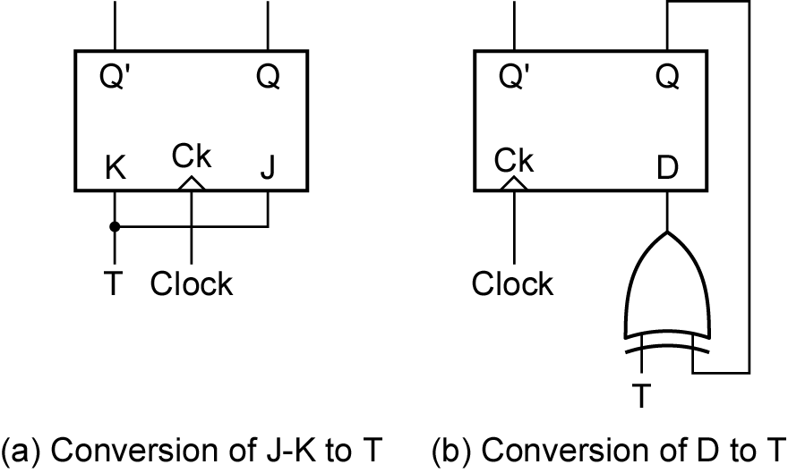
11.7 T Flip-Flop
Figure 11-24 Implementation of T Flip-Flop

Slide 19
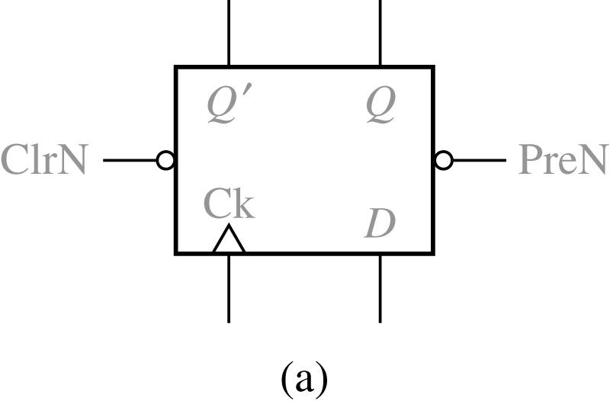
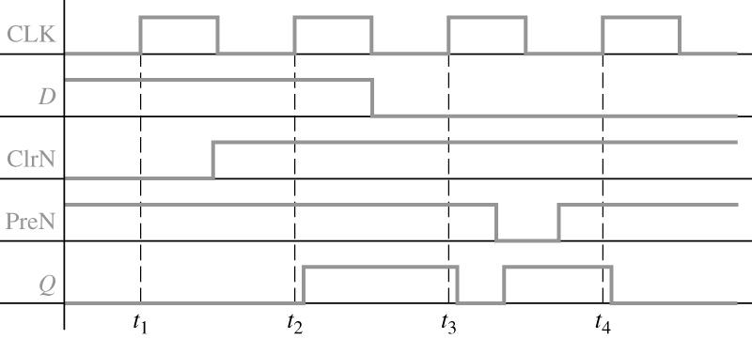
11.8 Flip-Flops with Additional Inputs
Figure 11-25 D Flip-Flop with Clear and Preset
x x 0 0 x x 0 1 x x 1 0 0 1 1 1 1 1 0,1, x 1 1 | (not allowed) 1 0 0 1 Q(no charge)
Figure 11-26 Timing Diagram for D Flip-Flop with Asynchronous Clear and Preset

Slide 20
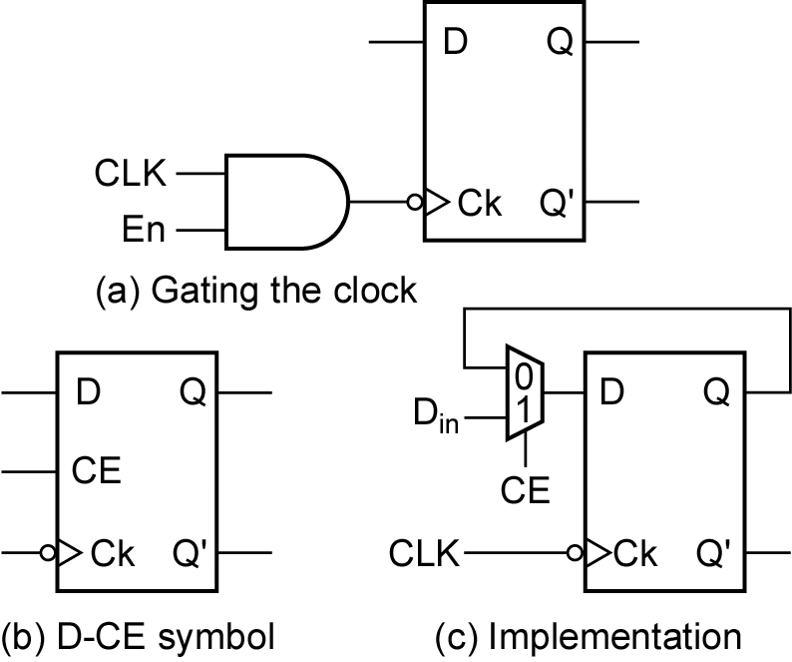
11.8 Flip-Flops with Additional Inputs
Figure 11-27 D Flip-Flop with Clock Enable
The characteristic equation
The MUX output

Slide 21
11.9 Summary
(S-R latch or flip-flop)
(Gated D latch)
(D flip-flop)
(D-CE flip-flop)
(J-K flip-flop)
(T flip-flop)

